Slide 1
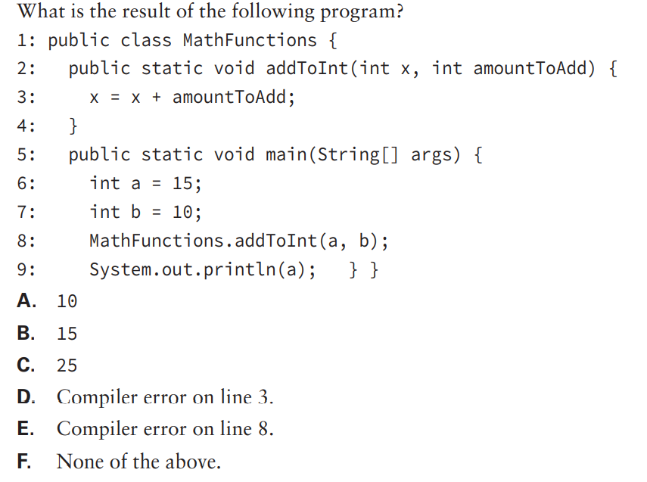
Notes:
B. The code compiles successfully, so options D and E are incorrect. The value of a cannot be changed by the addToInt method, no matter what the method does, because only a copy of the variable is passed into the parameter x. Therefore, a does not change and the output on line 9 is 15

Slide 2
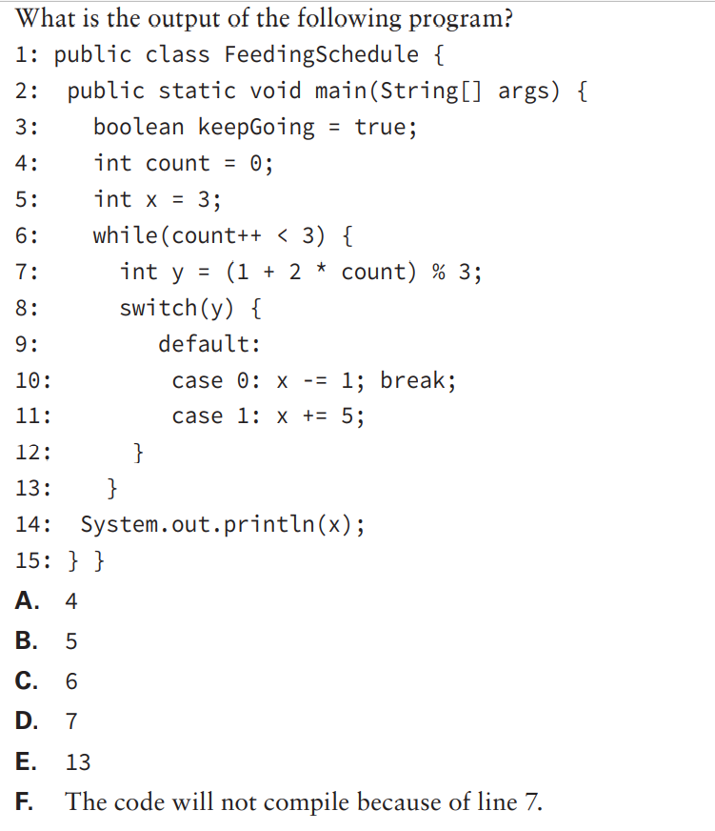
Notes:
C. The code compiles and runs without issue; therefore, option F is incorrect.
This type of problem is best examined one loop iteration at a time:
■ The loop continues as count loop expression evaluates to 0 < 3, which is true, with y taking a new value of 1. The value of y is set to: y = (1 + 2 * 1) % 3 = (1 + 2) % 3 = 3 % 3 = 0
■ The first case block is called and the value of x is then set to: x = 3 - 1 = 2
■ The loop continues as count loop expression evaluates to 1 < 3, which is true, with y taking a new value of 2. The value of y is set to: y = (1 + 2 * 2) % 3 = (1 + 4) % 3 = 4 % 3 = 2
■ The default block is called and the value of x is set to: x = 2 - 1 = 1
■ The loop continues as the count loop expression evaluates to 2 < 3, which is true, with y taking a new value of 3. The value of y is set to: y = (1 + 2 * 3) % 3 = (1 + 6) % 3 = 7 % 3 = 1
■ The second case block is called and the value of x is then set to: x = 1 + 5 = 6
■ The loop ends as the count loop expression evaluates to 3 < 3, with y also taking a new value of 4. The most recent value of x, 6, is output, so the answer is option C.

Slide 3
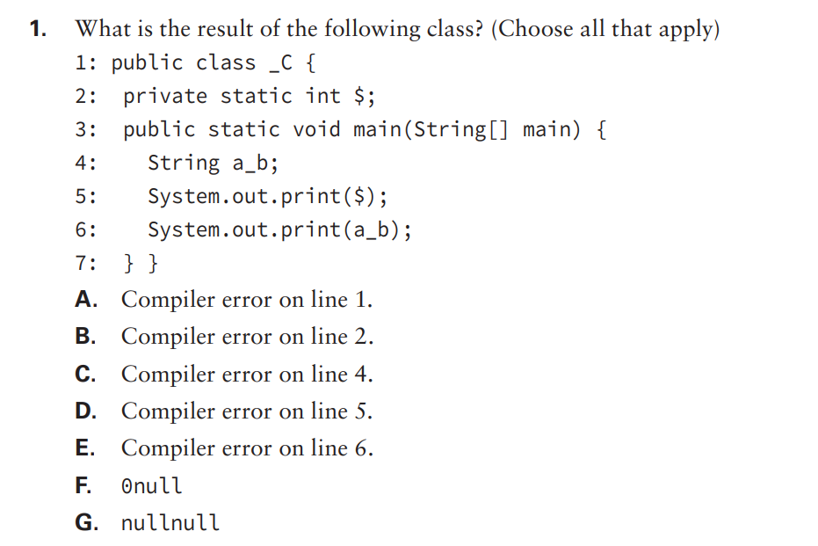
Notes:
E. Option E is correct because local variables require assignment before referencing them. Option D is incorrect because class and instance variables have default values and allow referencing. a_b defaults to a null value. Options A, B, and C are incorrect because identifiers may begin with a letter, underscore, or dollar sign. Options F and G are incorrect because the code does not compile. If a_b was an instance variable, the code would compile and output 0null.

Slide 4
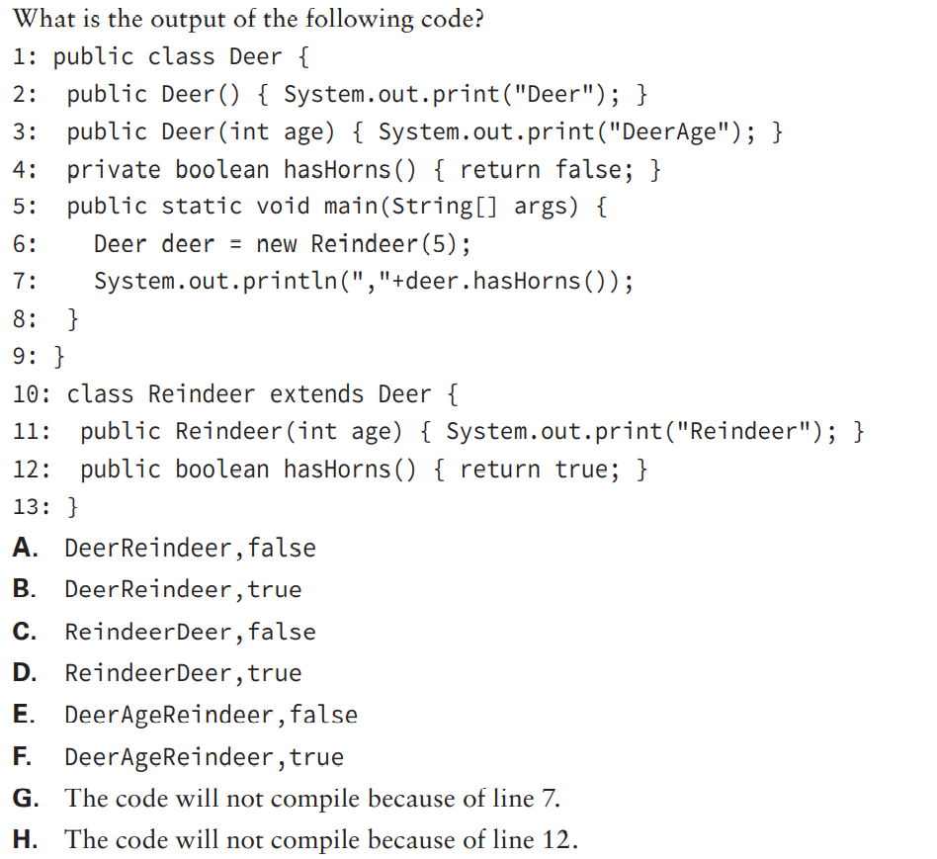
Notes:
A. The code compiles and runs without issue, so options G and H are incorrect. First, the Reindeer object is instantiated using the constructor that takes an int value. Since there is no explicit call to the parent constructor, the default no-argument super() is inserted as the first line of the constructor. The output is then Deer, followed by Reindeer in the child constructor, so only options A and B can be correct. Next, the method hasHorns() looks like an overridden method, but it is actually a hidden method since it is declared private in the parent class. Because the hidden method is referenced in the parent class, the parent version is used, so the code outputs false, and option A is the correct answer.

Slide 5
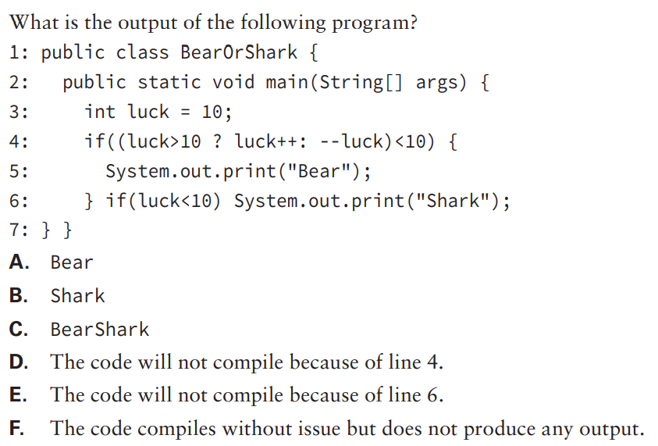
Notes:
C. The code compiles and runs without issue, so options D and E are correct. Remember that only one of the right-hand ternary expressions will be evaluated at runtime. Since luck is not less than 10, the second expression, --luck, will be evaluated, and since the pre-increment operator was used, the value returned will be 9, which is less than 10. So the first if-then statement will be visited and Bear will be output. Notice there is no else statement on line 6. Since luck is still less than 10, the second if-then statement will also be reached and Shark will be output; therefore, the correct answer is option C.

Slide 6
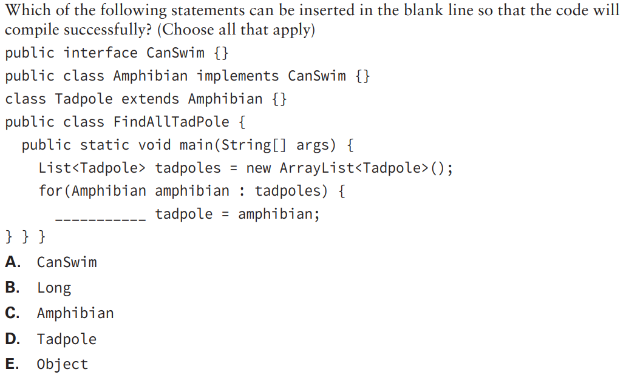
Notes:
A, C, E. The for-each loop automatically casts each Tadpole object to an Amphibian reference, which does not require an explicit cast because Tadpole is a subclass of Amphibian. From there, any parent class or interface that Amphibian inherits from is permitted without an explicit cast. This includes CanSwim, the interface Amphibian implements, and Object, which all classes extend from, so options A and E are correct. Option C is also correct since the reference is being cast to the same type, so no explicit cast is required. Option B is incorrect, since Long is not a parent of Amphibian. Option D is incorrect as well, although an explicit cast to Tadpole on the right-hand side of the expression would be required to allow the code to compile.

Slide 7
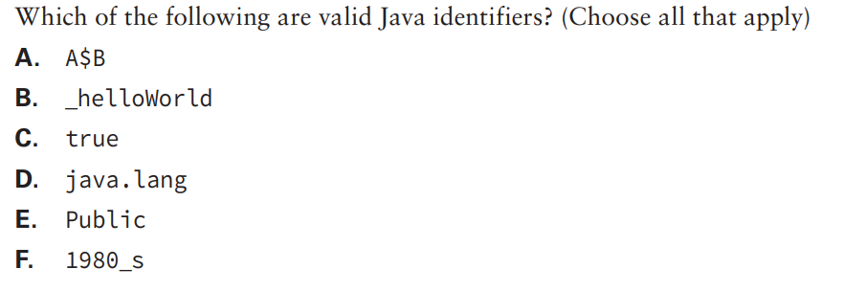
Notes:
A, B, E. Option A is valid because you can use the dollar sign in identifiers. Option B is valid because you can use an underscore in identifiers. Option C is not a valid identifier because true is a Java reserved word. Option D is not valid because the dot (.) is not allowed in identifiers. Option E is valid because Java is case sensitive, so Public is not a reserved word and therefore a valid identifier. Option F is not valid because the first character is not a letter, $, or _.

Slide 8
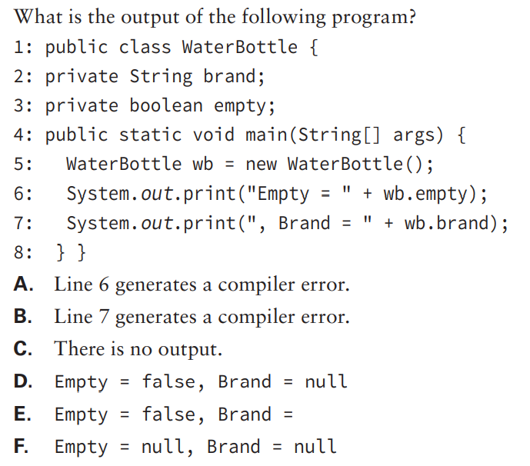
Notes:
D. Boolean fields initialize to false and references initialize to null, so empty is false and brand is null. Brand = null is output.

Slide 9
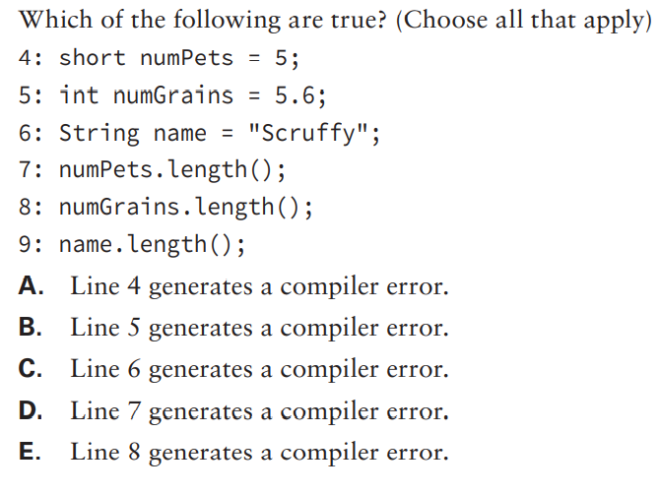
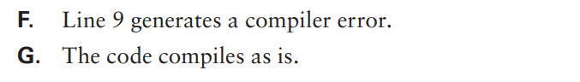
Notes:
B, D, E. Option A (line 4) compiles because short is an integral type. Option B (line 5) generates a compiler error because int is an integral type, but 5.6 is a floating-point type. Option C (line 6) compiles because it is assigned a String. Options D and E (lines 7 and 8) do not compile because short and int are primitives. Primitives do not allow methods to be called on them. Option F (line 9) compiles because length() is defined on String

Slide 10
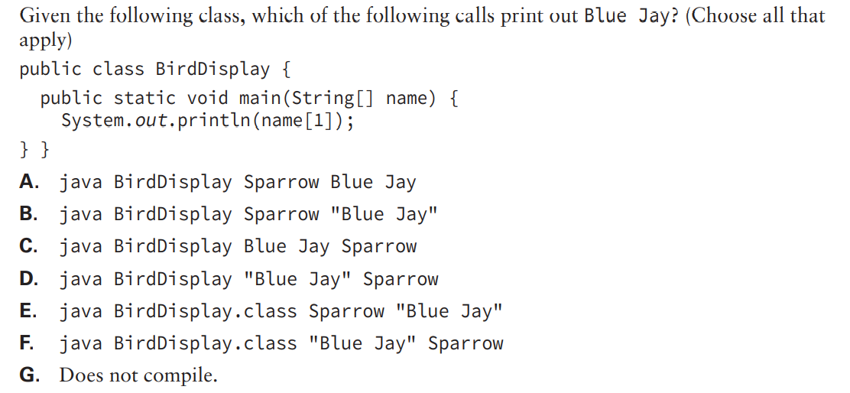
Notes:
B. Option B is correct because arrays start counting from zero and strings with spaces must be in quotes. Option A is incorrect because it outputs Blue. C is incorrect because it outputs Jay. Option D is incorrect because it outputs Sparrow. Options E and F are incorrect because they output Error: Could not find or load main class BirdDisplay.class.

Slide 11
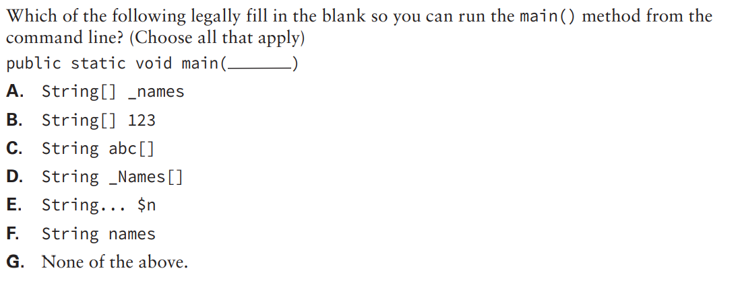
Notes:
A, C, D, E. Option A is correct because it is the traditional main() method signature and variables may begin with underscores. Options C and D are correct because the array operator may appear after the variable name. Option E is correct because varargs are allowed in place of an array. Option B is incorrect because variables are not allowed to begin with a digit. Option F is incorrect because the argument must be an array or varargs. Option F is a perfectly good method. However, it is not one that can be run from the command line because it has the wrong parameter type.

Slide 12
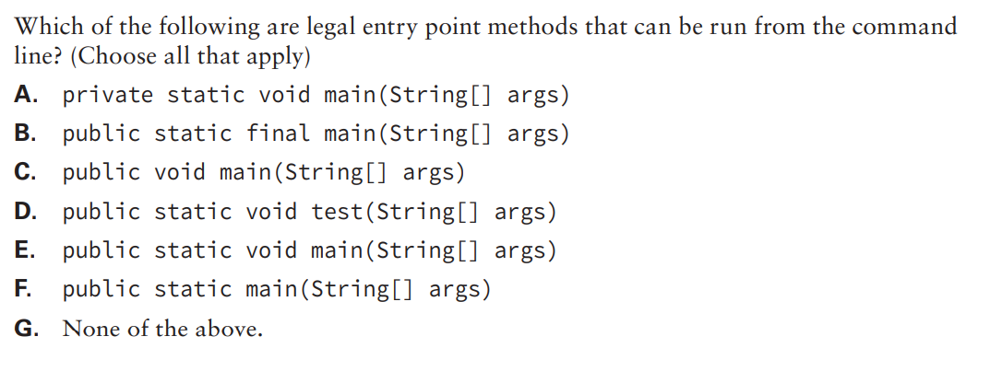
Notes:
E. Option E is the canonical main() method signature. You need to memorize it. Option A is incorrect because the main() method must be public. Options B and F are incorrect because the main() method must have a void return type. Option C is incorrect because the main() method must be static. Option D is incorrect because the main() method must be named main.

Slide 13
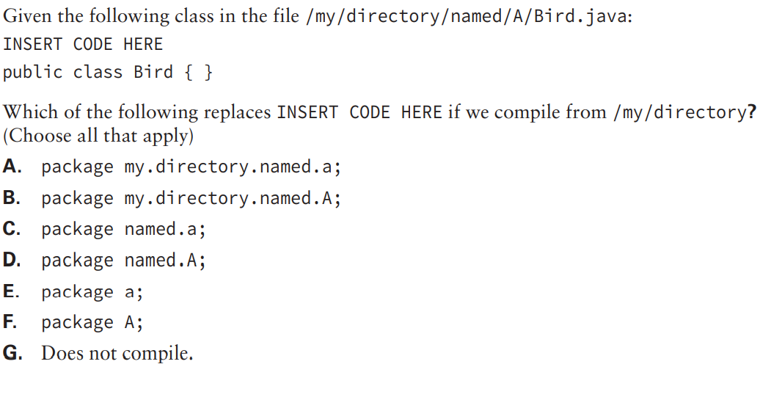
Notes:
D. The package name represents any folders underneath the current path, which is named.A in this case. Option B is incorrect because package names are case sensitive, just like variable names and other identifiers.

Slide 14
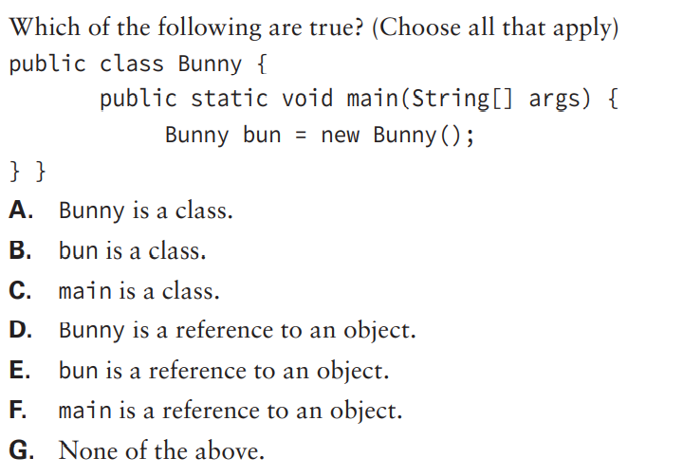
Notes:
A, E. Bunny is a class, which can be seen from the declaration: public class Bunny. bun is a reference to an object. main() is a method.

Slide 15
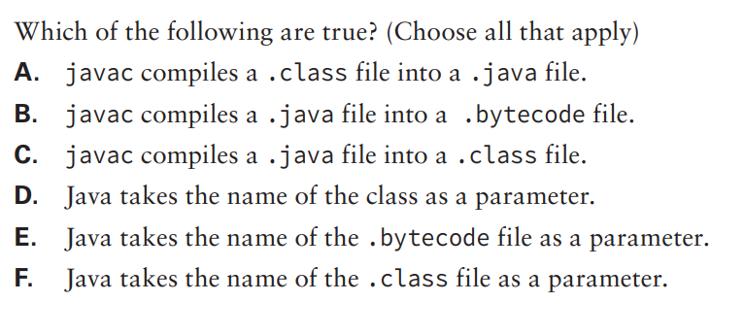
Notes:
C, D. Java puts source code in .java files and bytecode in .class files. It does not use a .bytecode file. When running a Java program, you pass just the name of the class without the .class extension.

Slide 16
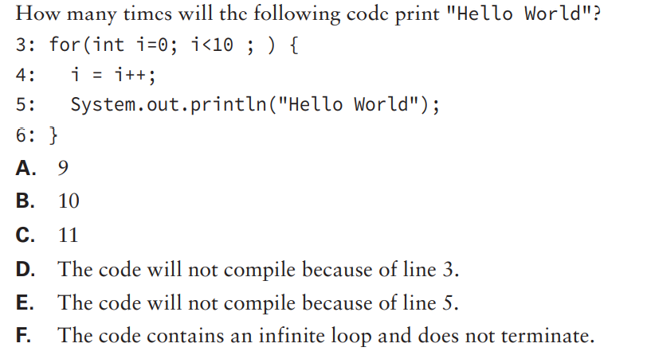
Notes:
F. In this example, the update statement of the for loop is missing, which is fine as the statement is optional, so option D is incorrect. The expression inside the loop increments i but then assigns i the old value. Therefore, i ends the loop with the same value that it starts with: 0. The loop will repeat infinitely, outputting the same statement over and over again because i remains 0 after every iteration of the loop

Slide 17
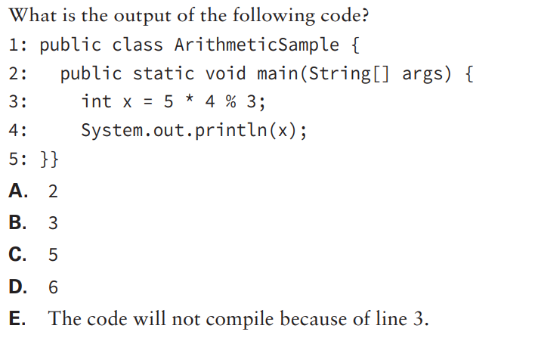
Notes:
A. The * and % have the same operator precedence, so the expression is evaluated from left-to-right. The result of 5 * 4 is 20, and 20 % 3 is 2 (20 divided by 3 is 18, the remainder is 2). The output is 2 and option A is the correct answer.

Slide 18
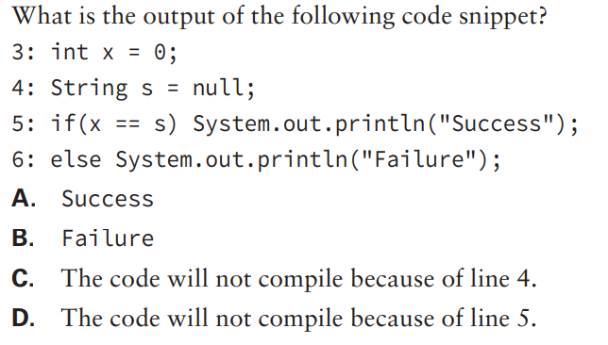
Notes:
D. The variable x is an int and s is a reference to a String object. The two data types are incomparable because neither variable can be converted to the other variable’s type. The compiler error occurs on line 5 when the comparison is attempted, so the answer is option D.

Slide 19
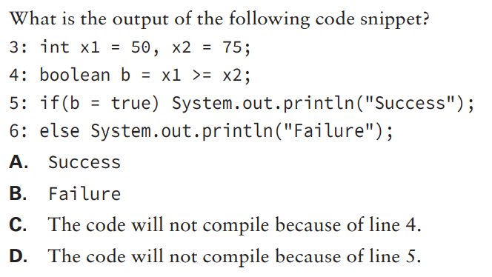
Notes:
A. The code compiles successfully, so options C and D are incorrect. The value of b after line 4 is false. However, the if-then statement on line 5 contains an assignment, not a comparison. The variable b is assigned true on line 3, and the assignment operator returns true, so line 5 executes and displays Success, so the answer is option A

Slide 20
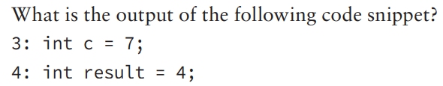
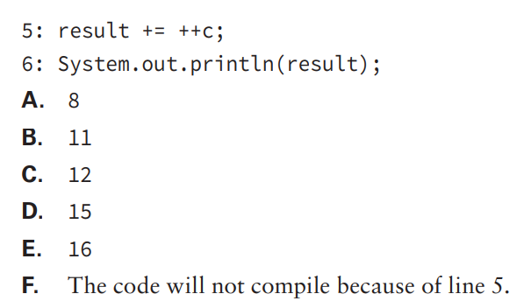
Notes:
C. The code compiles successfully, so option F is incorrect. On line 5, the pre-increment operator is used, so c is incremented to 4 and the new value is returned to the expression. The value of result is computed by adding 4 to the original value of 8, resulting in a new value of 12, which is output on line 6. Therefore, option C is the correct answer.

Slide 21
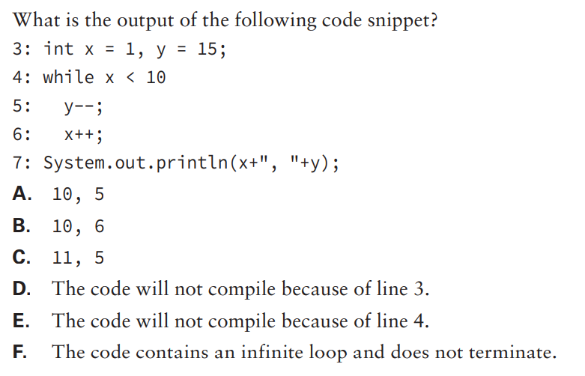
Notes:
E. This is actually a much simpler problem than it appears to be. The while statement on line 4 is missing parentheses, so the code will not compile, and option E is the correct answer. If the parentheses were added, though, option F would be the correct answer since the loop does not use curly braces to include x++ and the boolean expression never changes. Finally, if curly braces were added around both expressions, the output would be 10, 6 and option B would be correct.

Slide 22
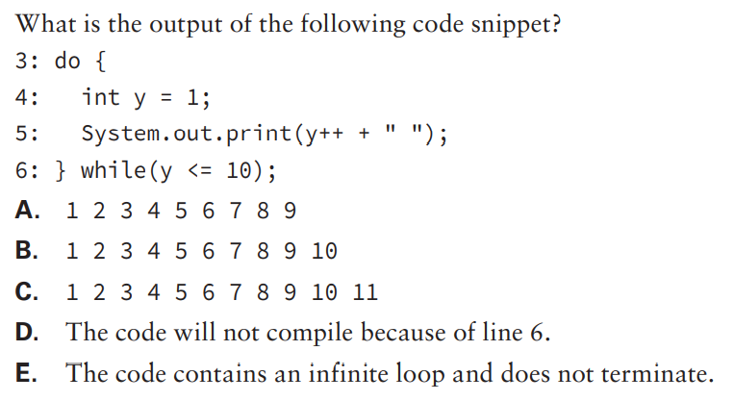
Notes:
D. The variable y is declared within the body of the do-while statement, so it is out of scope on line 6. Line 6 generates a compiler error, so option D is the correct answer.

Slide 23
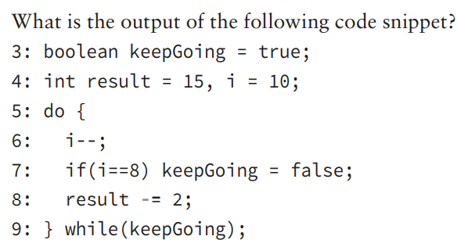
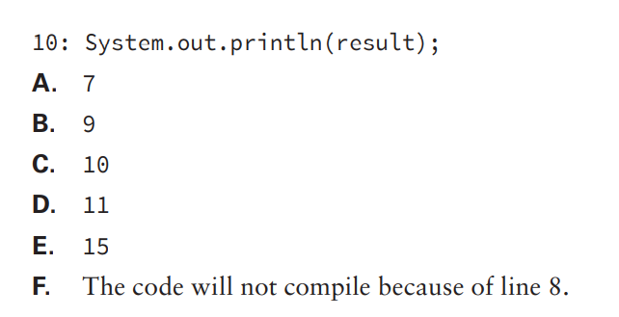
Notes:
D. The code compiles without issue, so option F is incorrect. After the first execution of the loop, i is decremented to 9 and result to 13. Since i is not 8, keepGoing is false, and the loop continues. On the next iteration, i is decremented to 8 and result to 11. On the second execution, i does equal 8, so keepGoing is set to false. At the conclusion of the loop, the loop terminates since keepGoing is no longer true. The value of result is 11, and the correct answer is option D

Slide 24
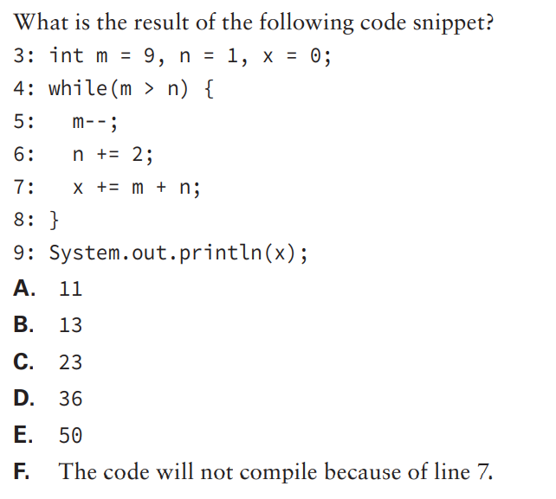
Notes:
D. Prior to the first iteration, m = 9, n = 1, and x = 0. After the iteration of the first loop, m is updated to 8, n to 3, and x to the sum of the new values for m + n, 0 + 11 = 11. After the iteration of the second loop, m is updated to 7, n to 5, and x to the sum of the new values for m + n, 11 + 12 = 23. After the iteration of the third loop, m is updated to 6, n to 7, and x to the sum of the new values for m + n, 23 + 13 = 36. On the fourth iteration of the loop, m > n evaluates to false, as 6 < 7 is not true. The loop ends and the most recent value of x, 36, is output, so the correct answer is option D.

Slide 25
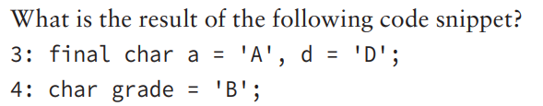
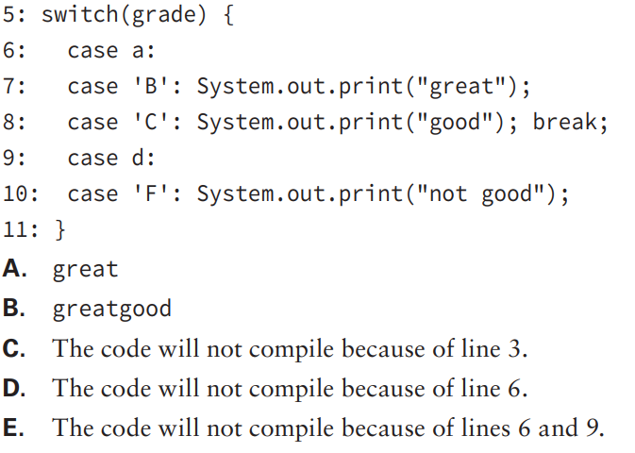
Notes:
B. The code compiles and runs without issue, so options C, D, and E are not correct. The value of grade is 'B' and there is a matching case statement that will cause "great" to be printed. There is no break statement after the case, though, so the next case statement will be reached, and "good" will be printed. There is a break after this case statement, though, so the switch statement will end. The correct answer is thus option B.

Slide 26
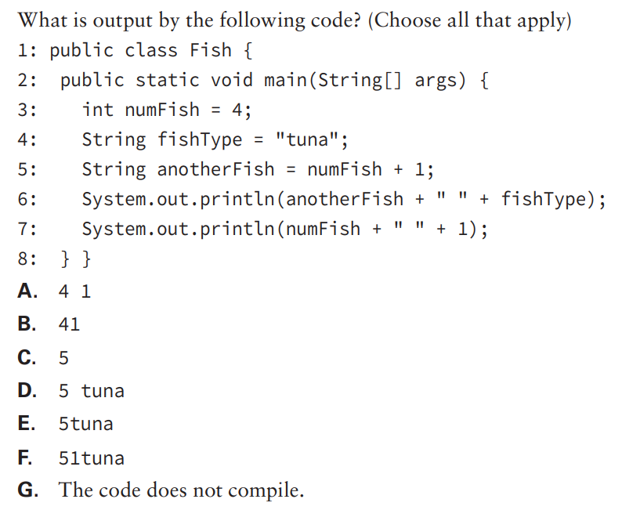
Notes:
G. Line 5 does not compile. This question is checking to see if you are paying attention to the types. numFish is an int and 1 is an int. Therefore, we use numeric addition and get 5. The problem is that we can’t store an int in a String variable. Supposing line 5 said String anotherFish = numFish + 1 + "";. In that case, the answer would be options A and D. The variable defined on line 5 would be the string "5", and both output statements would use concatenation.

Slide 27
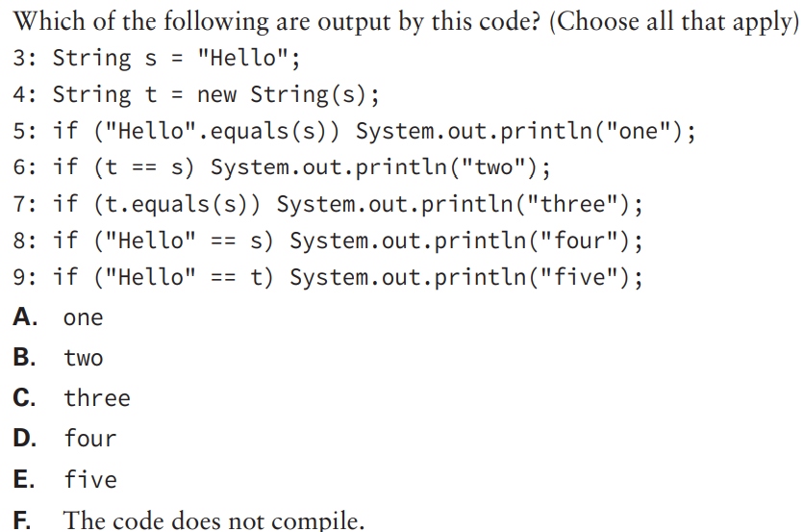
Notes:
A, C, D. The code compiles fine. Line 3 points to the String in the string pool. Line 4 calls the String constructor explicitly and is therefore a different object than s. Lines 5 and 7 check for object equality, which is true, and so print one and three. Line 6 uses object reference equality, which is not true since we have different objects. Line 7 also compares references but is true since both references point to the object from the string pool. Finally, line 8 compares one object from the string pool with one that was explicitly constructed and returns false.

Slide 28
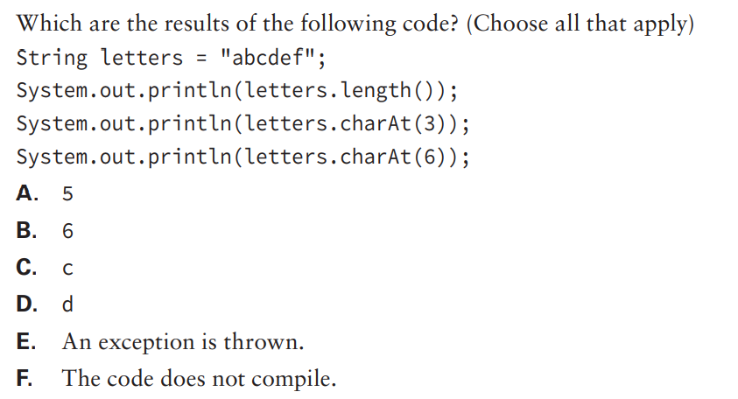
Notes:
B, D, E. length() is simply a count of the number of characters in a String. In this case, there are six characters. charAt() returns the character at that index. Remember that indexes are zero based, which means that index 3 corresponds to d and index 6 corresponds to 1 past the end of the array. A StringIndexOutOfBoundsException is thrown for the last line.

Slide 29
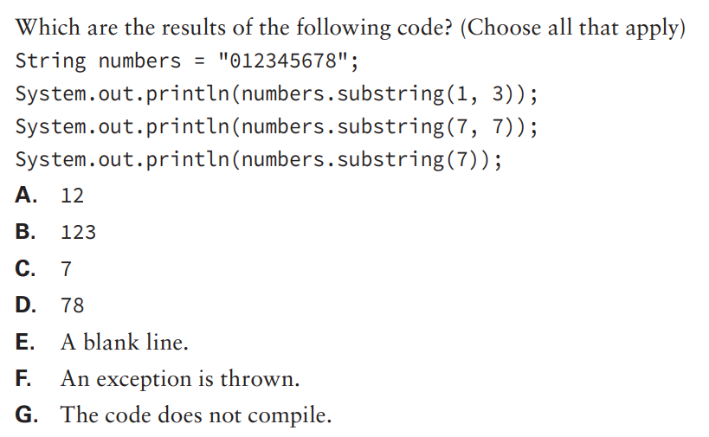
Notes:
A, D, E. substring() has two forms. The first takes the index to start with and the index to stop immediately before. The second takes just the index to start with and goes to the end of the String. Remember that indexes are zero based. The first call starts at index 1 and ends with index 2 since it needs to stop before index 3. The second call starts at index 7 and ends in the same place, resulting in an empty String. This prints out a blank line. The final call starts at index 7 and goes to the end of the String.

Slide 30
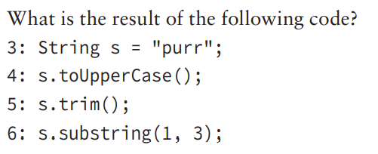
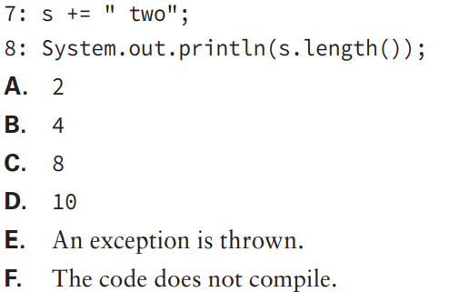
Notes:
C. This question is trying to see if you know that String objects are immutable. Line 4 returns "PURR" but the result is ignored and not stored in s. Line 5 returns "purr" since there is no whitespace present but the result is again ignored. Line 6 returns "ur" because it starts with index 1 and ends before index 3 using zero-based indexes. The result is ignored again. Finally, on line 6 something happens. We concatenate four new characters to s and now have a String of length 8

Slide 31
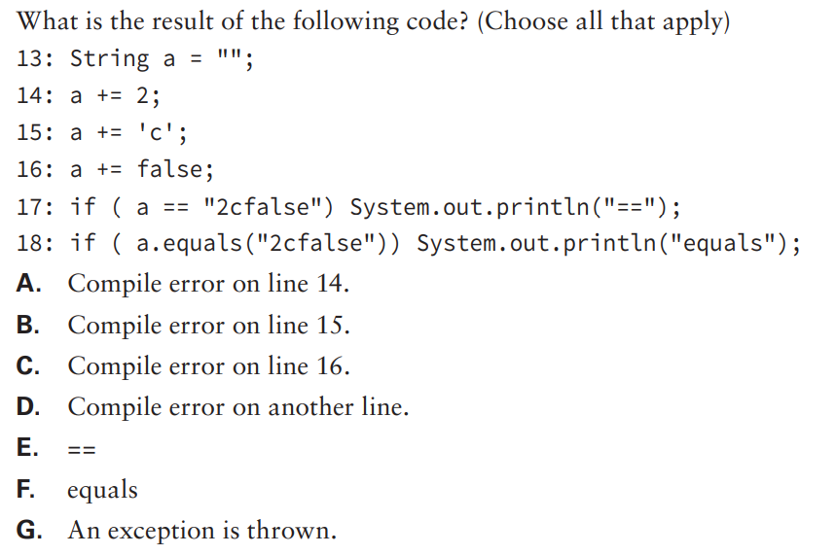
Notes:
F. a += 2 expands to a = a + 2. A String concatenated with any other type gives a String. Lines 14, 15, and 16 all append to a, giving a result of "2cfalse". The if statement on line 18 returns false because the values of the two String objects are the same using object equality. The if statement on line 17 returns false because the two String objects are not the same in memory. One comes directly from the string pool and the other comes from building using String operations.

Slide 32
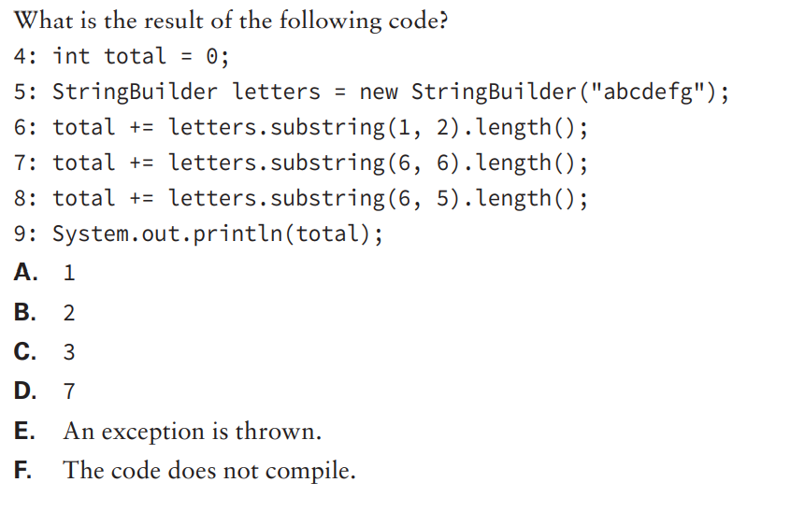
Notes:
E. Line 6 adds 1 to total because substring() includes the starting index but not the ending index. Line 7 adds 0 to total. Line 8 is a problem: Java does not allow the indexes to be specified in reverse order and the code throws a StringIndexOutOfBoundsException.

Slide 33
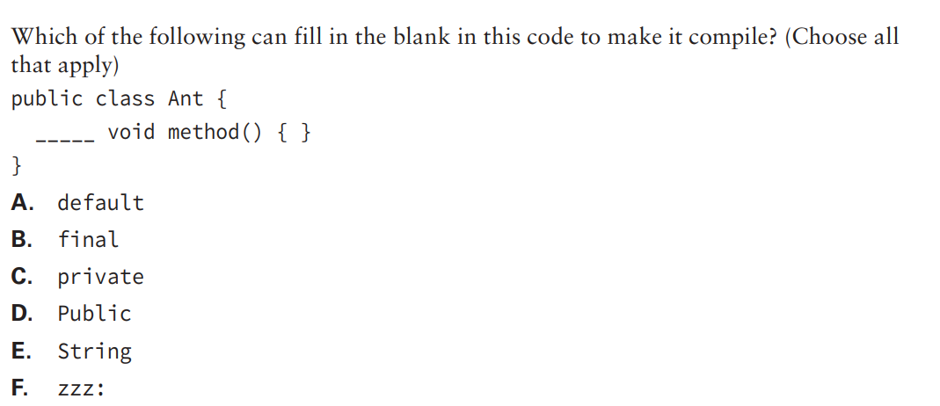
Notes:
B, C. void is a return type. Only the access modifier or optional specifiers are allowed before the return type. Option C is correct, creating a method with private access. Option B is correct, creating a method with default access and the optional specifier final. Since default access does not require a modifier, we get to jump right to final. Option A is incorrect because default access omits the access modifier rather than specifying default. Option D is incorrect because Java is case sensitive. It would have been correct if public were the choice. Option E is incorrect because the method already has a void return type. Option F is incorrect because labels are not allowed for methods.

Slide 34
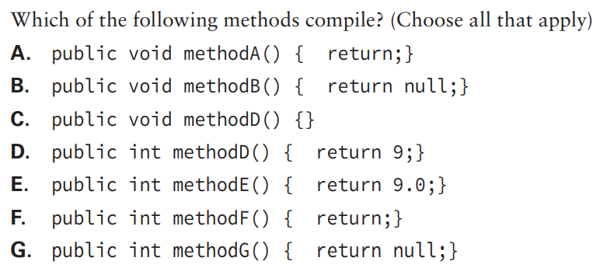
Notes:
A, C, D. Options A and C are correct because a void method is allowed to have a return statement as long as it doesn’t try to return a value. Options B and G do not compile because null requires a reference object as the return type. void is not a reference object since it is a marker for no return type. int is not a reference object since it is a primitive. Option D is correct because it returns an int value. Option E does not compile because it tries to return a double when the return type is int. Since a double cannot be assigned to an int, it cannot be returned as one either. Option F does not compile because no value is actually returned

